Slide 1
Secure Data Hiding in Images using Steganography
CAPSTONE PROJECT
Presented By: Sanskar Pandey
College Name: Lakshmi Narain College Of Technology, Bhopal
Department: Internet Of Things and Cyber Security Including
Blockchain Technology

Slide 2
OUTLINE
Problem Statement
Technology used
Wow factor
End users
Result
Conclusion
Git-hub Link
Future scope

Slide 3
Problem Statement
In the digital era, securing sensitive information is crucial. Traditional encryption methods can attract unwanted attention, making hidden communication challenging.
This project addresses the need for secure and covert message transmission by embedding secret messages within images using image steganography.
It ensures confidentiality by requiring a password for both encryption and decryption, making the hidden data accessible only to authorized users.
Additionally, the project provides a user-friendly GUI for seamless encryption and decryption, enhancing accessibility and ease of use.

Slide 4
Technology used
Python – Core programming language for the project.
OpenCV – Used for image processing.
Tkinter – GUI framework for user interaction.
NumPy – Efficient handling of image pixel data.
PIL (Pillow) – Image manipulation library for format compatibility.

Slide 5
Wow factors
Invisible Encryption: The message is hidden within the image without visible changes.
Password Protection: Ensures only authorized users can retrieve the message.
GUI-Based Implementation: Easy-to-use graphical interface for seamless interaction.
Automated Pixel Management: The system dynamically adjusts pixel storage to prevent errors.
Future-Ready: Can be extended for AI-driven steganography or blockchain-based security.

Slide 6
End users
Cybersecurity Professionals: For secure data transmission.
Journalists & Whistleblowers: To communicate sensitive information discreetly.
Government & Intelligence Agencies: For confidential communication.
Researchers & Academicians: For experimenting with steganography techniques.
General Users: To protect private messages from unauthorized access.

Slide 7
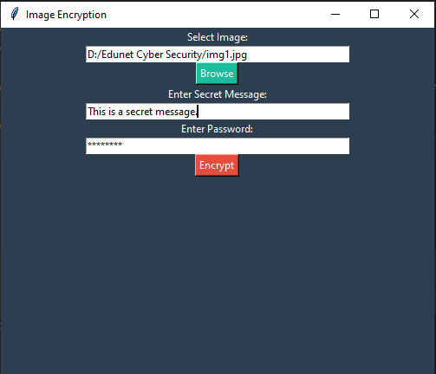
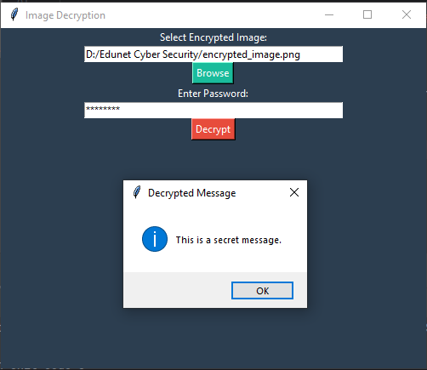
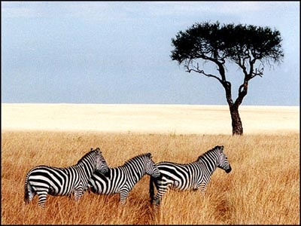
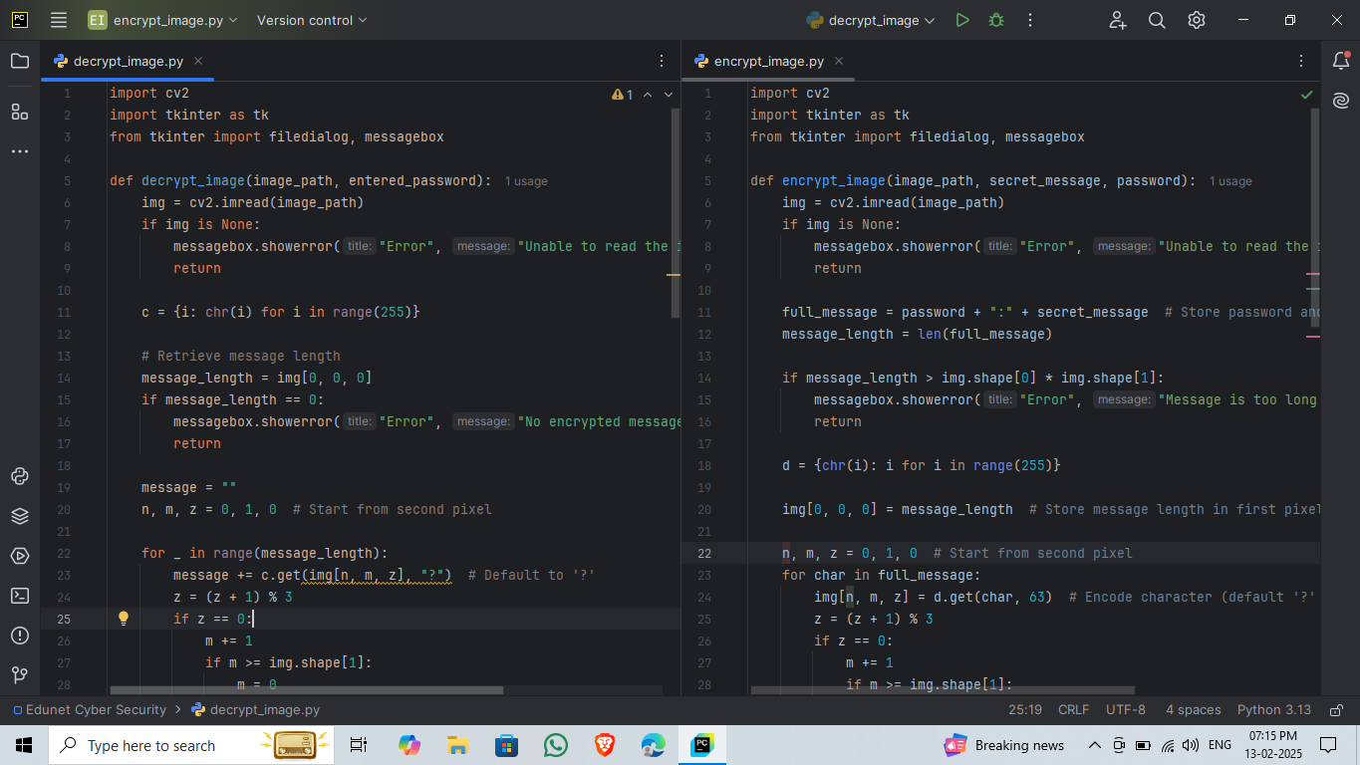
Results

Slide 8
Conclusion
The project successfully implements image-based steganography for secure communication.
It provides a user-friendly, password-protected solution for embedding and extracting messages.
The system ensures data confidentiality while keeping the original image visually unchanged.
It can be enhanced with advanced encryption algorithms and AI-powered detection resistance.

Slide 9
GitHub Link
sanskarpandey005/Secure-Data-Hiding-in-Images-using-Steganography

Slide 10
Future scope(optional)
Stronger Encryption: Implement AES or RSA encryption before embedding data.
Multi-Format Support: Extend functionality for PNG, BMP, and GIF images.
AI-Based Security: Use AI to prevent detection by steganalysis tools.
Mobile & Web Integration: Develop an Android/iOS app for wider accessibility.
Cloud Storage Integration: Secure message embedding with remote access via cloud platforms.

Slide 11
THANK YOU

